Slide 1
Data Analytics Pipeline
in
Google Cloud Platform
for
Consumer Reviews of Amazon Products
Project Group #1
Team Members:
Viritha Vanama - 015356991
Aneshaa Kasula - 014558427
Mohini Patil - 015359188

Slide 2
Project Overview
Our project deals with capturing customer reviews about products sold on the Amazon website and streamlining the captured data using GCP, which could be leveraged for various analytics.
Amazon hosts many variants of any given product from different manufacturers, it is the reviews & ratings from fellow customers which help others in making quick decisions on future purchases.
As data enthusiasts, in this project, we are trying to analyze a couple of scenarios about consumer behavior.

Slide 3
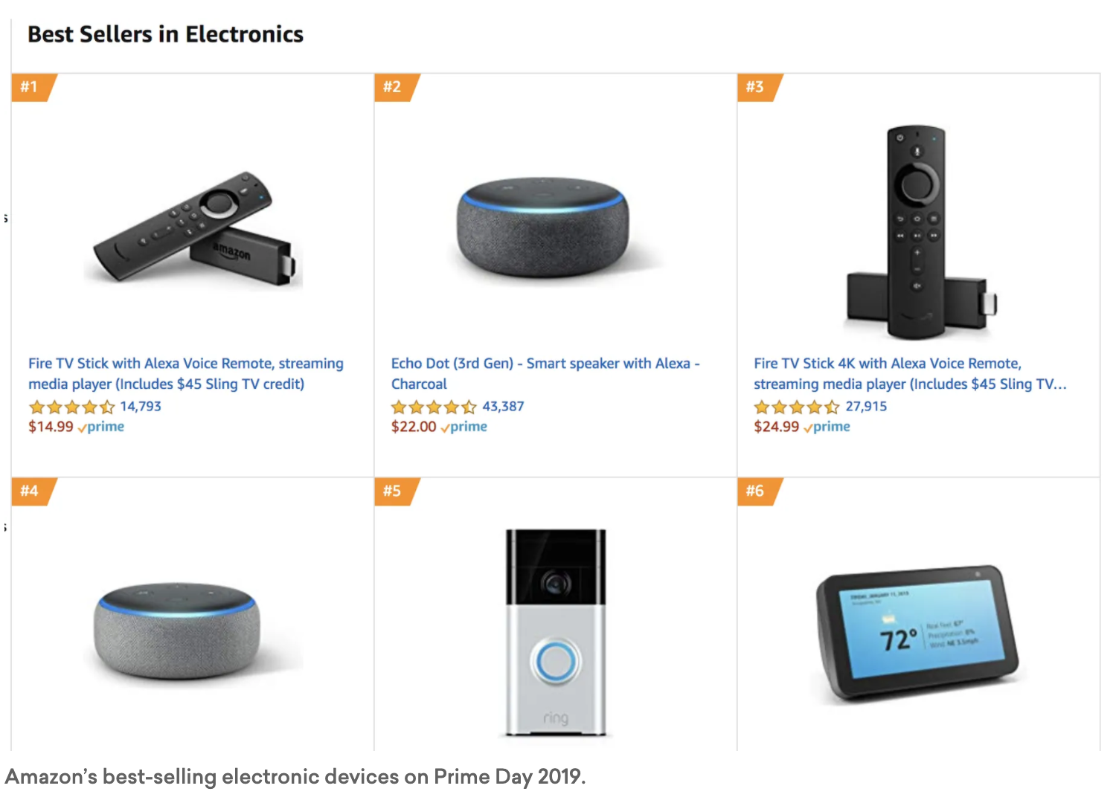
Objectives
Our objective is to build a scalable and efficient data analytics pipeline architecture that completes the data-to-information transformation process which is the key factor in the success of any analytics.
We are building a Data Analytics pipeline in Google Cloud Platform on amazon product reviews dataset to achieve the following goals:
Most reviewed products
Most rated products
Popular category based on gender
The popularity of free shipping products
End-Users will be Marketing & Sales Department along with Sellers.

Slide 4
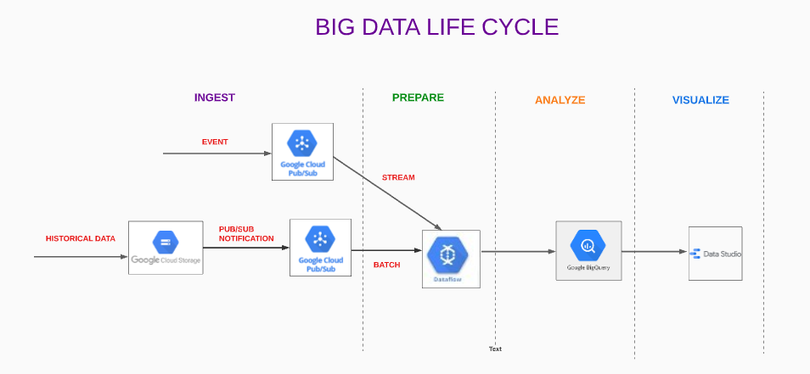
Data analytics pipeline architecture diagram

Slide 5
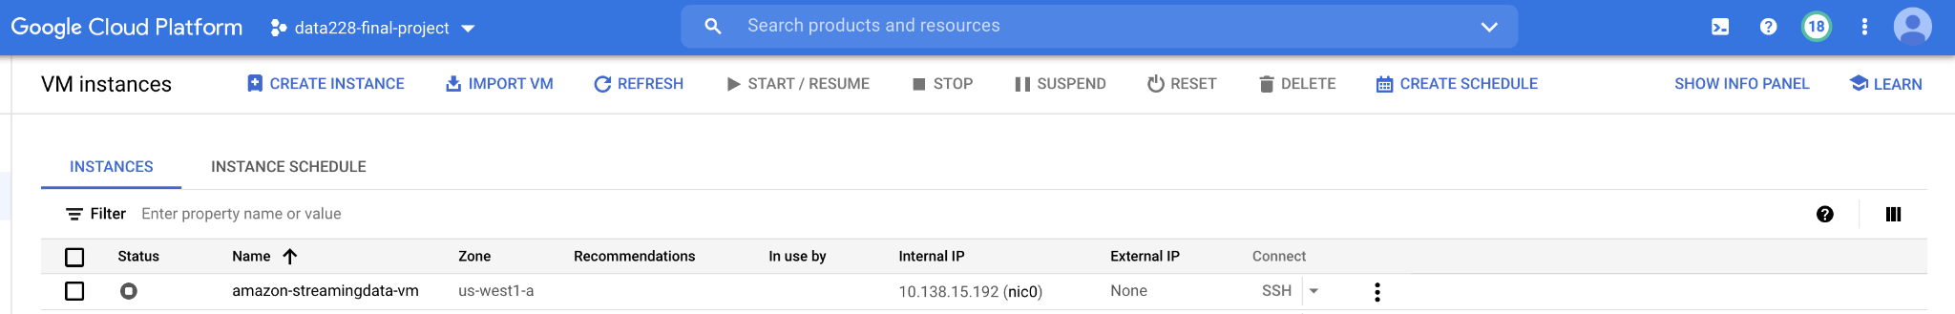
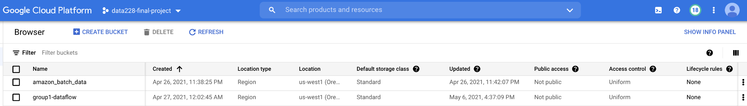
Environmental setup
Created a new project “data228-final-project” in Google Cloud Platform.
1 Compute Instance : amazon-streamingdata-vm
2 Storage Buckets :
Batch Data : amazon_batch_data
Stage and Temp Data Flow : group1-dataflow

Slide 6
Data Ingestion
About dataset
Source : Datafiniti’s dataset
We have chosen Amazon Customer Reviews which is one of the iconic datasets.
In a period of over two decades since the first review in 1995, millions of Amazon customers have contributed over a hundred million reviews to express opinions and describe their experiences regarding products on the Amazon.com website.
This dataset contains lists of consumer reviews and ratings for Amazon products with various categories such as electronics, home & garden, health & beauty, animals & pet supplies etc.
We generated couple of columns with data that are required for our objectives.

Slide 7
Batch Data Ingestion
Historical data will be stored as csv file in google cloud storage, that includes basic product information, reviews and ratings given by users.
We are using GCP Pub/Sub to send notifications as a message, whenever a batch file is uploaded into a specific cloud storage bucket.
This message will be published to a specific topic which includes the metadata of the file in json format.
Setup in GCP
Created a new bucket amazon_batch_data in google cloud storage to store batch files.
Created a topic batch_fileupload_notification in pub/sub to publish a message when a new batch file is triggered in GCS amazon_batch_data.

Slide 8

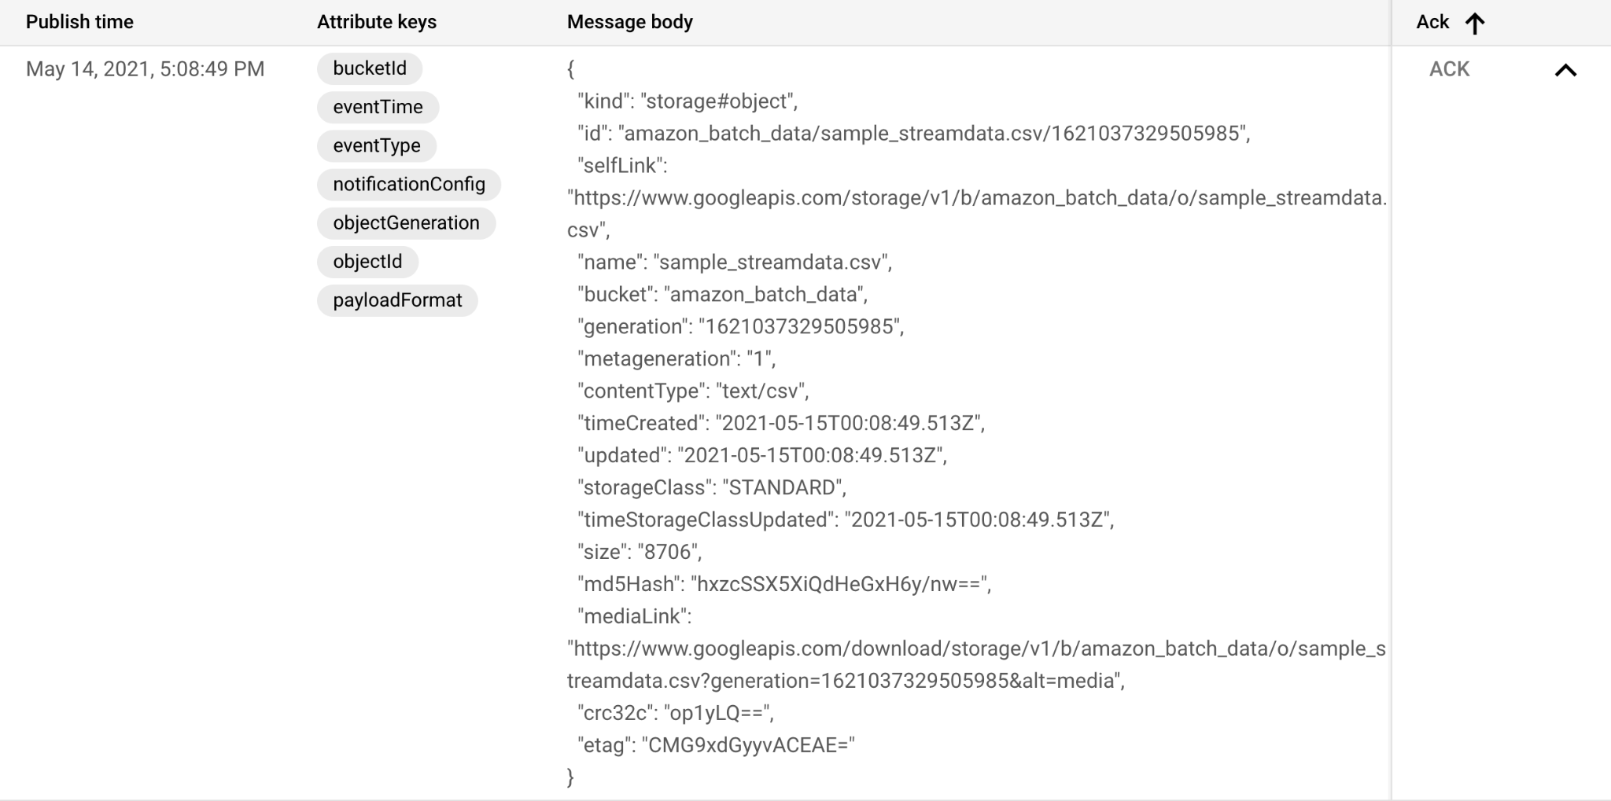
Batch Data Ingestion continued

Slide 9
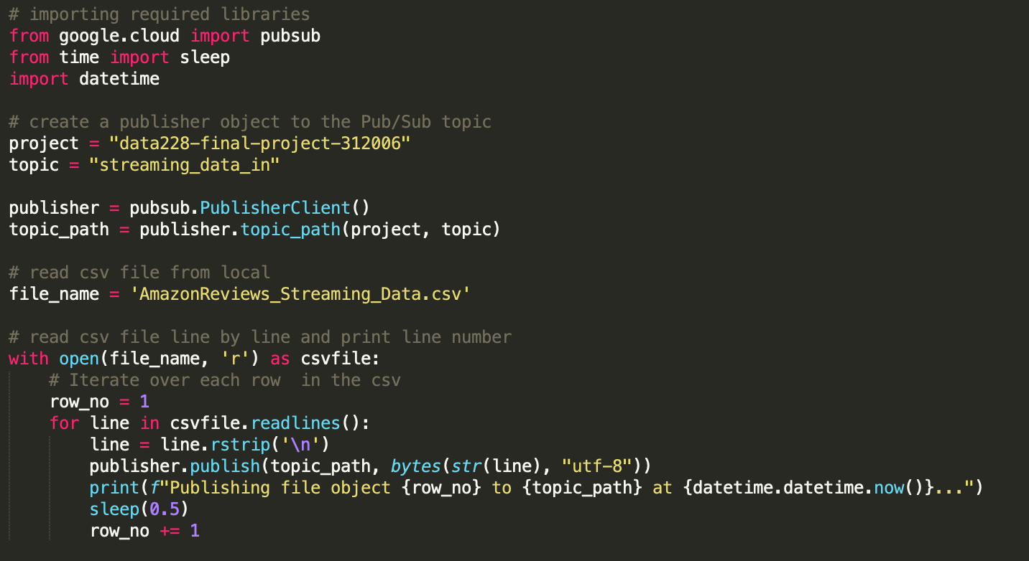
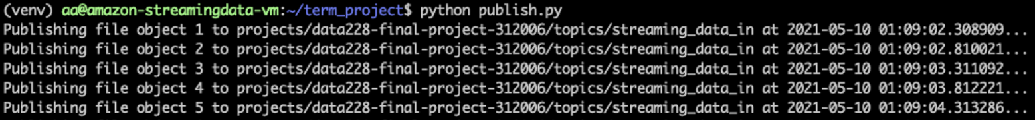
Streaming Data Ingestion
Streaming Data
We are publishing messages through a python program from vm(venv) which reads the data from a csv file and publishes messages to a pub-sub topic.
Setup in GCP
Created a topic streaming_data_in to publish streaming data.

Slide 10
Data Preparation
Batch Data
Dataflow(Apache Beam Python) is used for the ETL processing.
Dataflow subscribes to the topic that publishes the metadata of the batch file.
From the metadata, the bucket and file name details are extracted;file path is constructed and file is accessed.
Streaming Data
Same Dataflow is used for processing Streaming Data as well.
Dataflow subscribes to the streaming topic in a fixed time window.

Slide 11
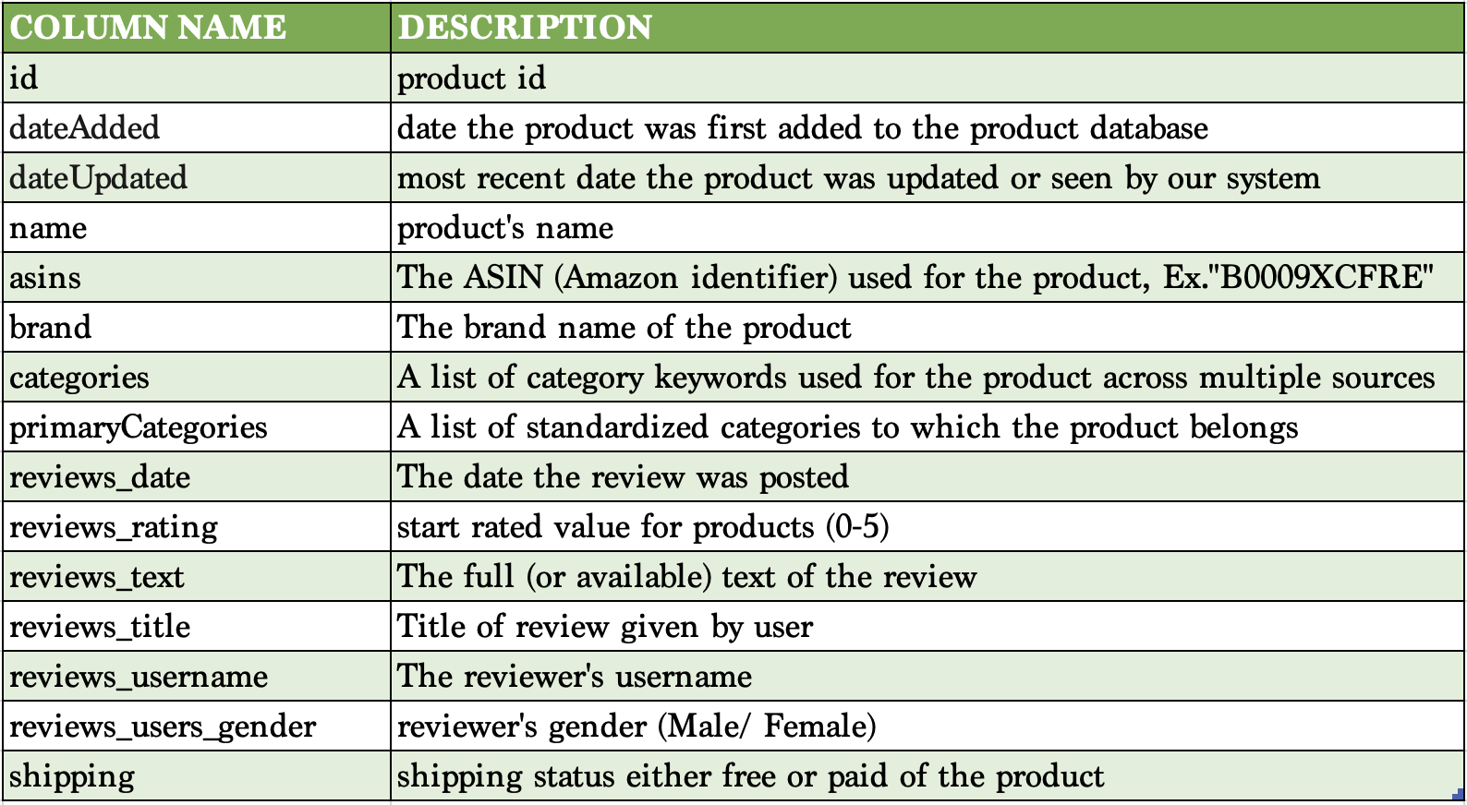

Data Preparation
Both Streaming and Batch data go through same steps of cleaning, filtering and formatting in the dataflow.

Slide 12
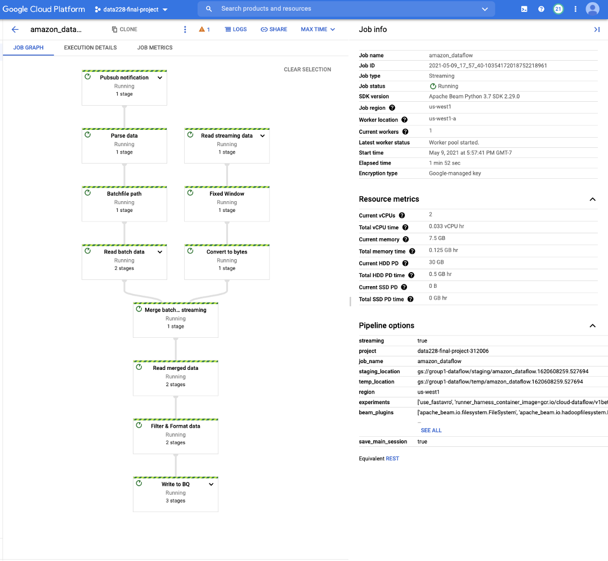
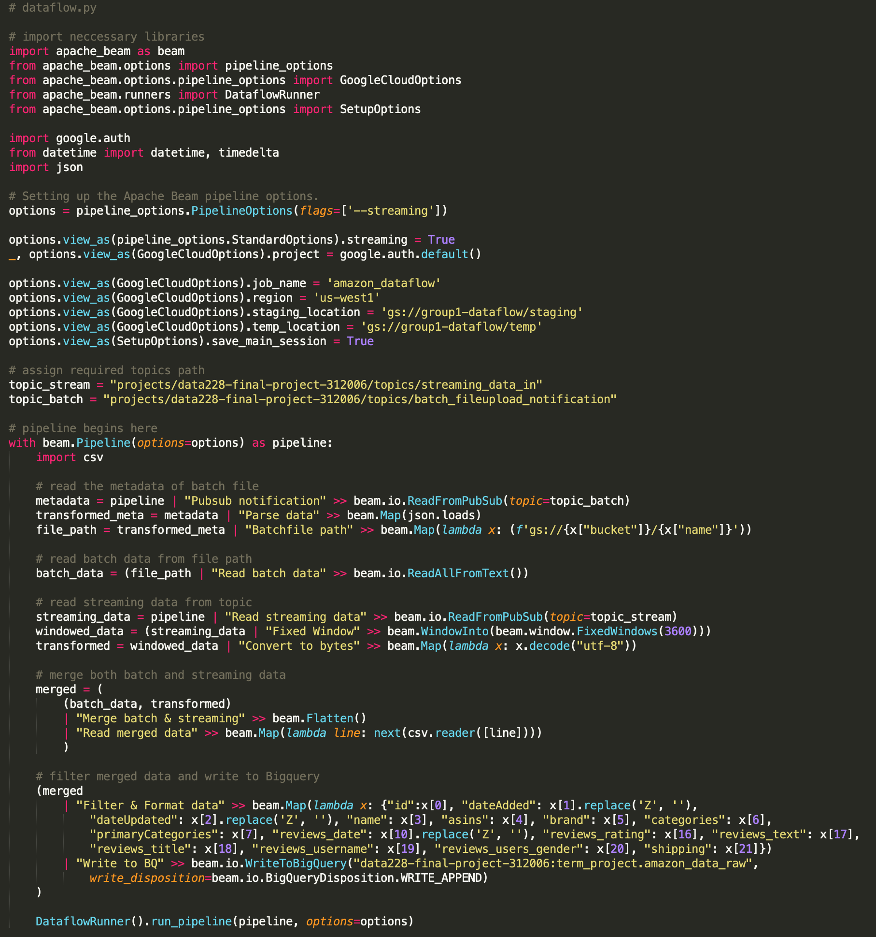
DataFlow Job

Slide 13
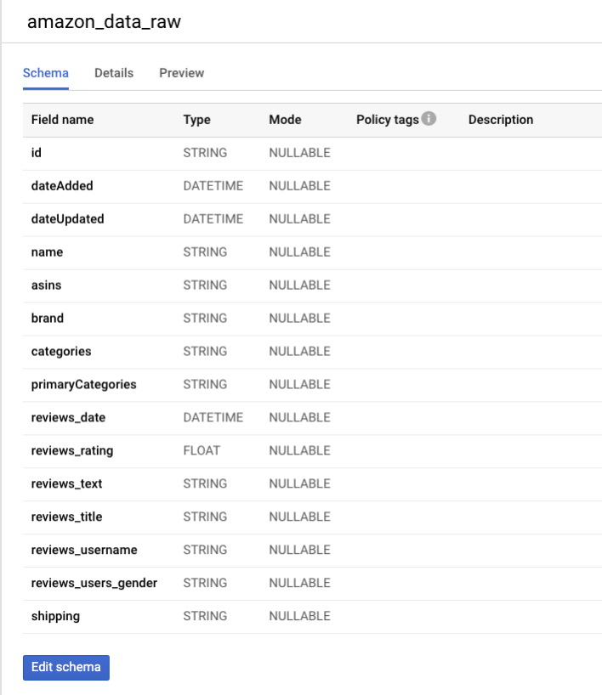
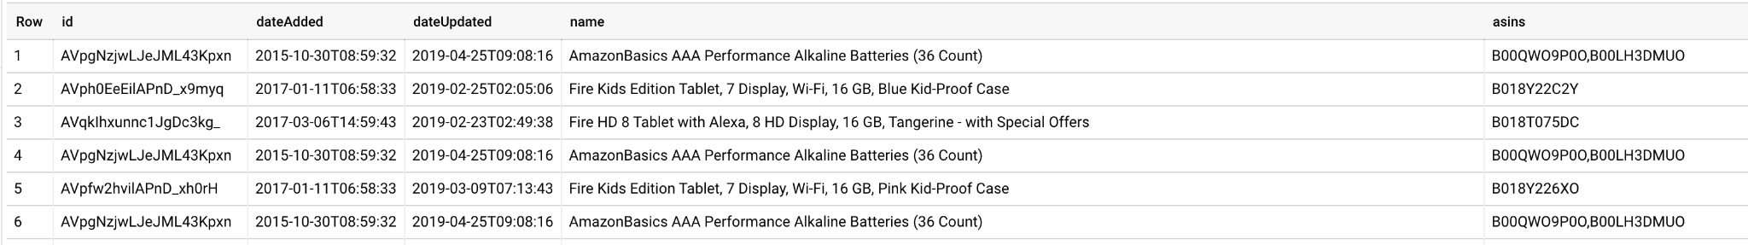
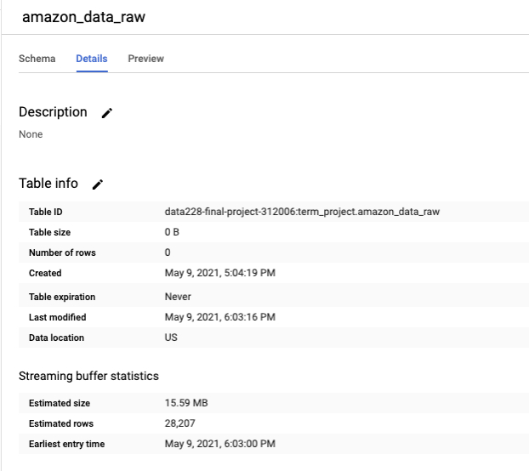
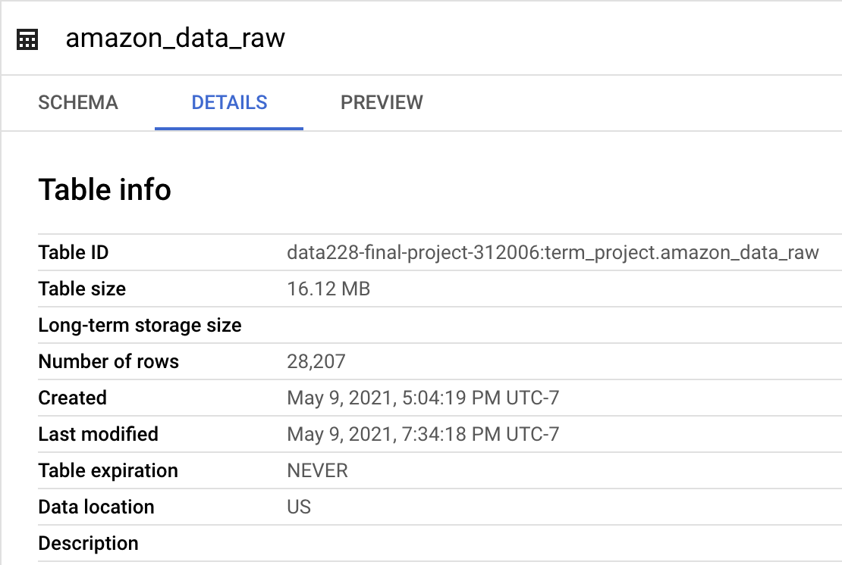
BigQuery Table Schema, Details and Preview of data

Slide 14
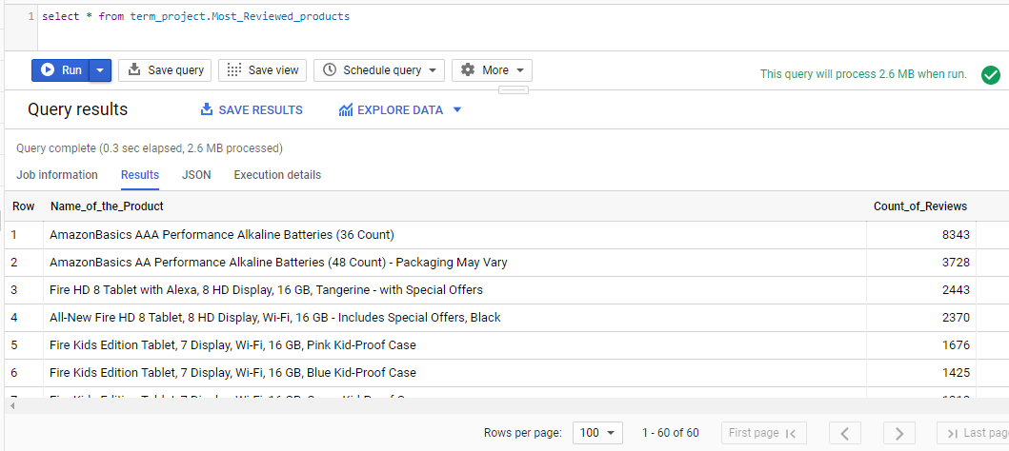
Data Analytics
Most_Reviewed_products
Create or replace view term_project.Most_Reviewed_products
as
SELECT
name AS Name_of_the_Product,
COUNT(reviews_title) AS Count_of_Reviews
FROM term_project.amazon_data_raw
GROUP BY name
ORDER BY COUNT(reviews_title) DESC;

Slide 15
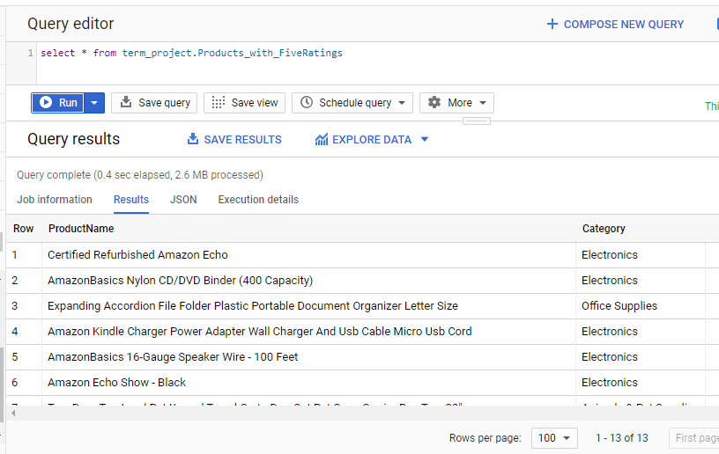
Products_with_FiveRatings
Create or replace view term_project.Products_with_FiveRatings
as
SELECT ProductName, Category
FROM (
SELECT
name AS ProductName,
primaryCategories AS Category,
AVG(reviews_rating) AS Rating
FROM term_project.amazon_data_raw
GROUP BY name, primaryCategories
HAVING AVG(reviews_rating) = 5.0
ORDER BY AVG(reviews_rating) DESC
);

Slide 16
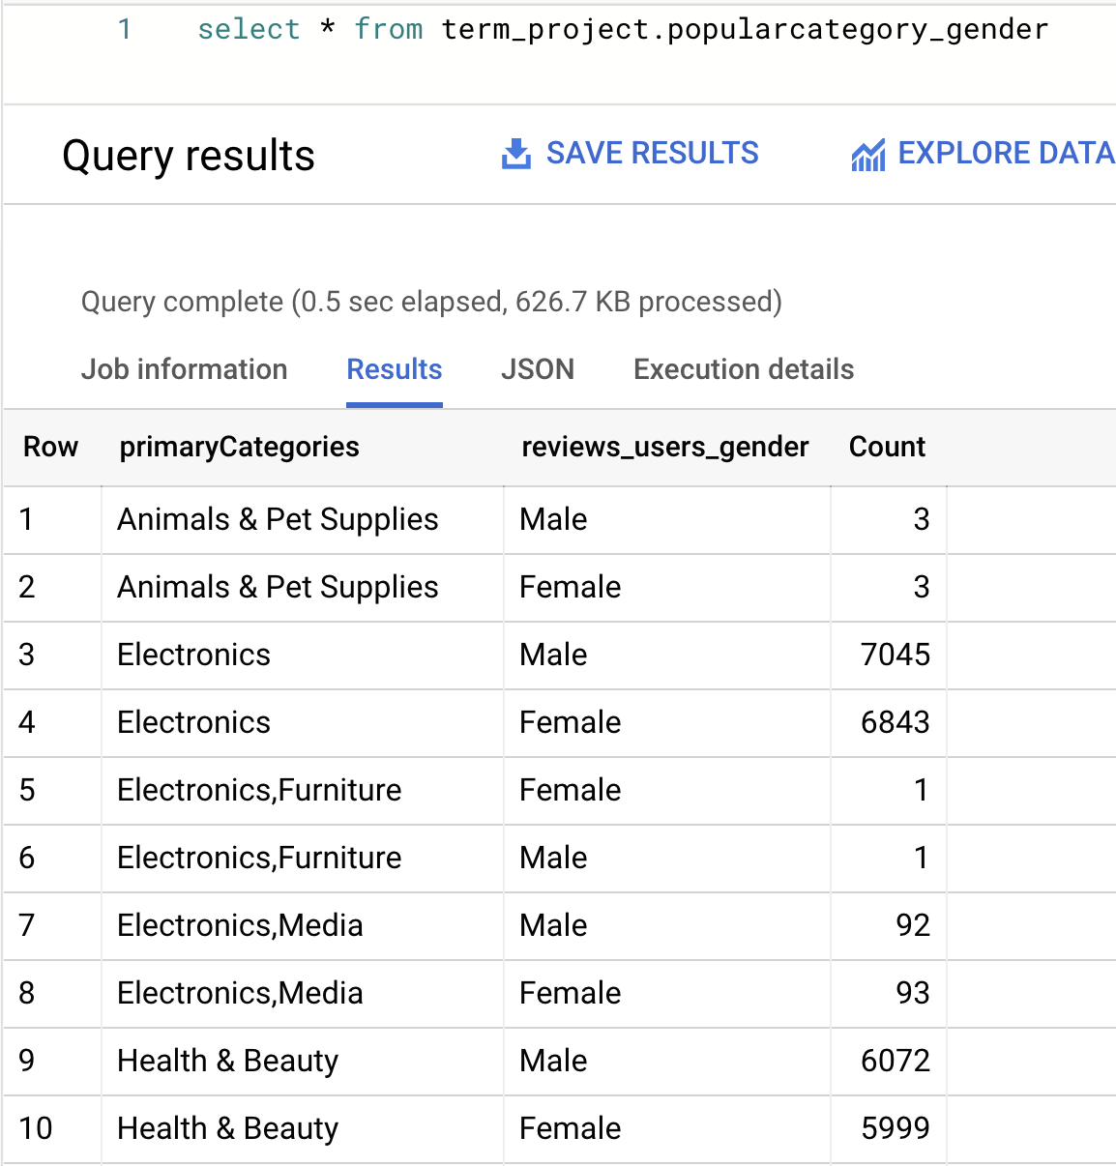
Popularcategory_gender
Create or replace view term_project.popularcategory_gender as
SELECT
primaryCategories,
reviews_users_gender,
count(*) as Count
FROM `data228-final-project-312006.term_project.amazon_data_raw`
GROUP BY primaryCategories,reviews_users_gender
ORDER BY primaryCategories

Slide 17
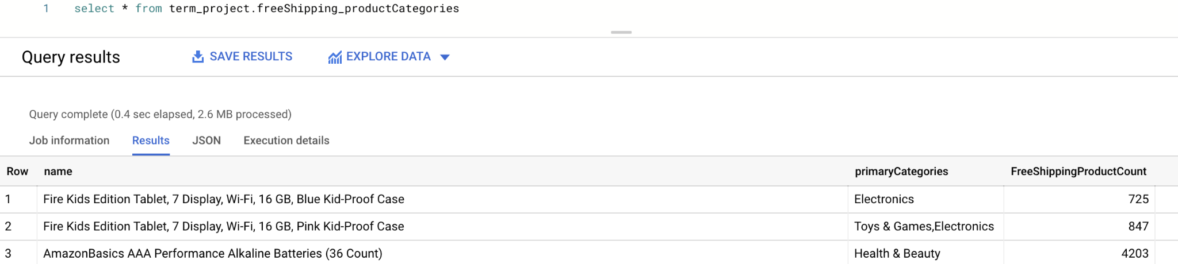
freeShipping_productCategories
Create or replace view term_project.freeShipping_productCategories
as
SELECT name, primaryCategories,
count(name) as FreeShippingProductCount
FROM term_project.amazon_data_raw
WHERE shipping = 'Free'
group by name, primaryCategories;

Slide 18
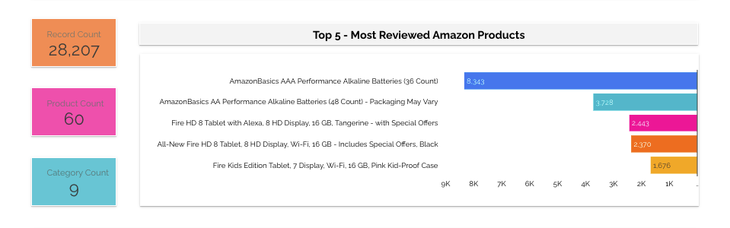
Data Visualization

Slide 19
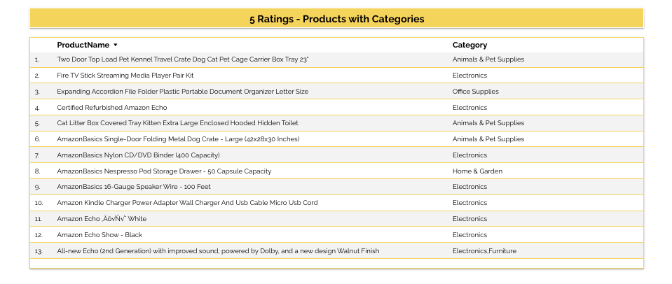

Slide 20
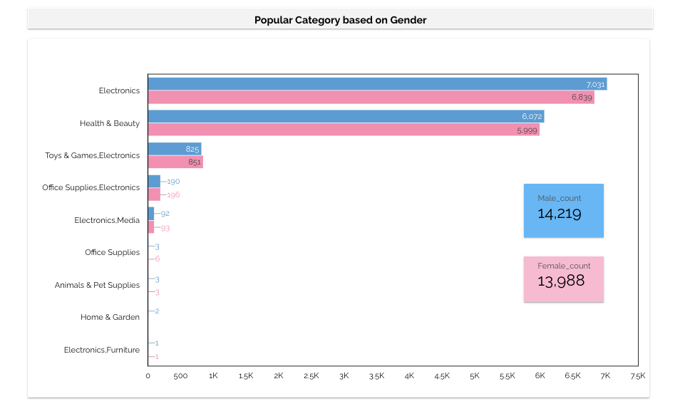

Slide 21
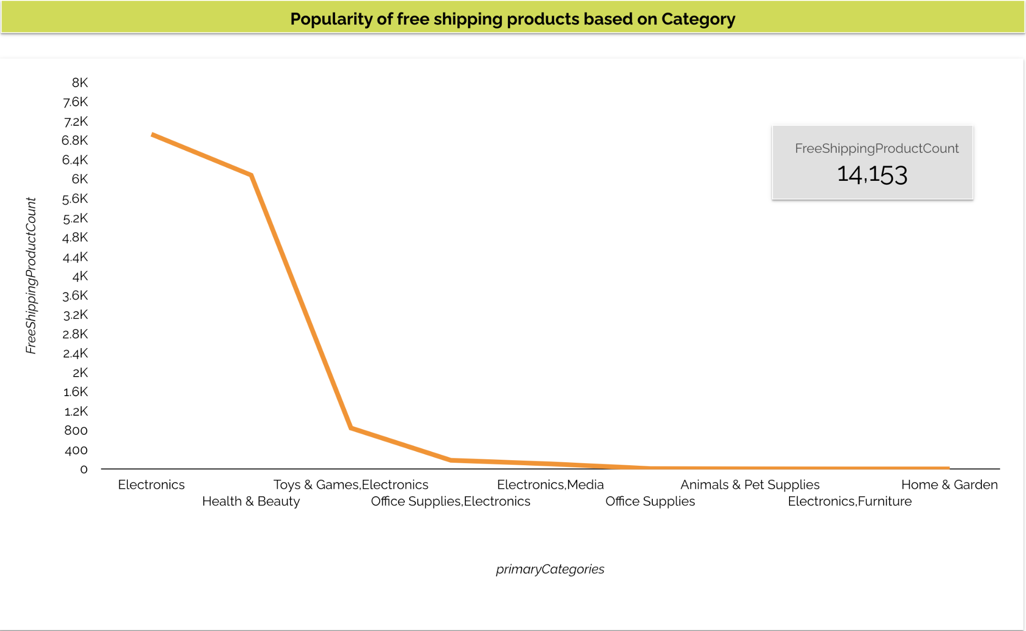

Slide 22
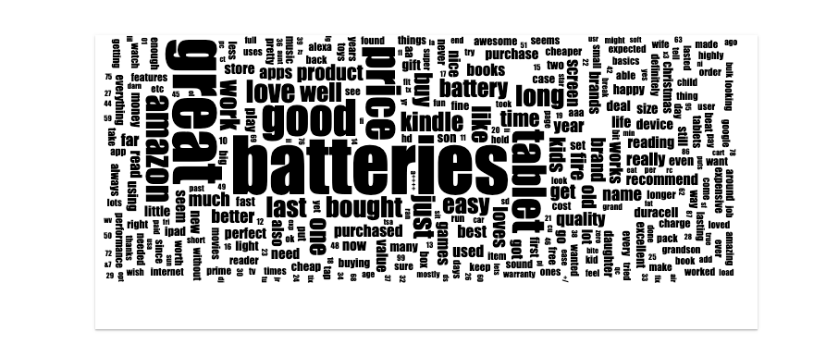
Word Cloud for overall Reviews
Higher the font size higher the frequency of that particular word has been used in Reviews.

Slide 23
Future Work
The word cloud visualization will be implemented in BQ rather than using 3rd party visualization tools directly.
Review sentiment analysis using BQ and ML modules.
Change the streaming ingestion from python program to api’s.
Based on fixed windows, get the record count and trending products as part of analysis.

Slide 24
Thank you !!!

